Slide 1
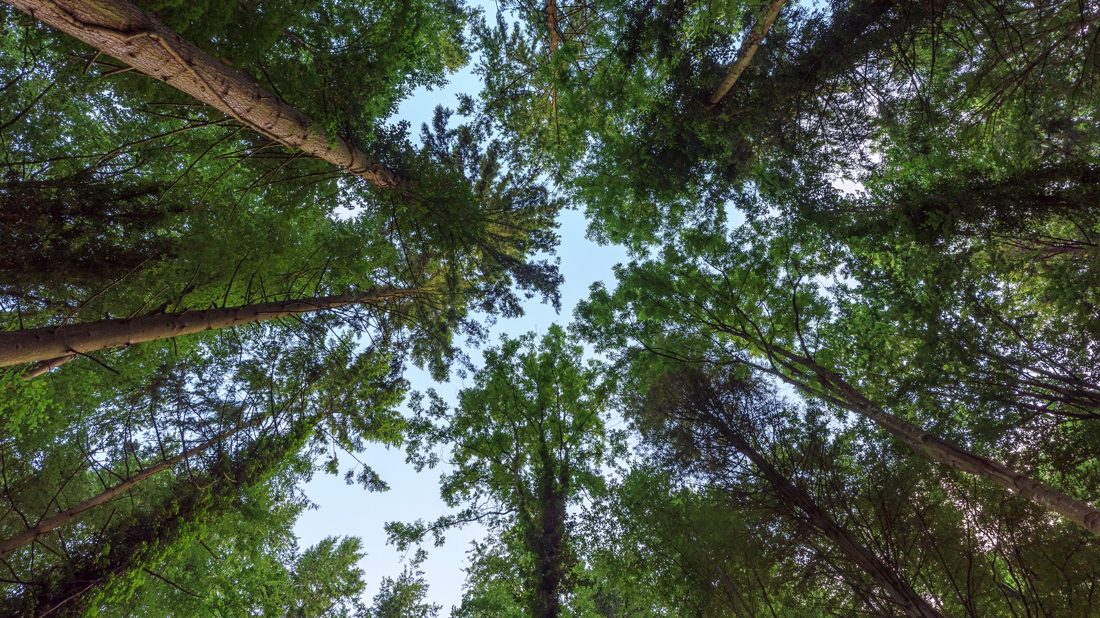

FruitPunch AI Code
https://fruitpunch.ai/code
Epoch 5: Random Forest
10.09.2019
M. Alican Noyan

Slide 4
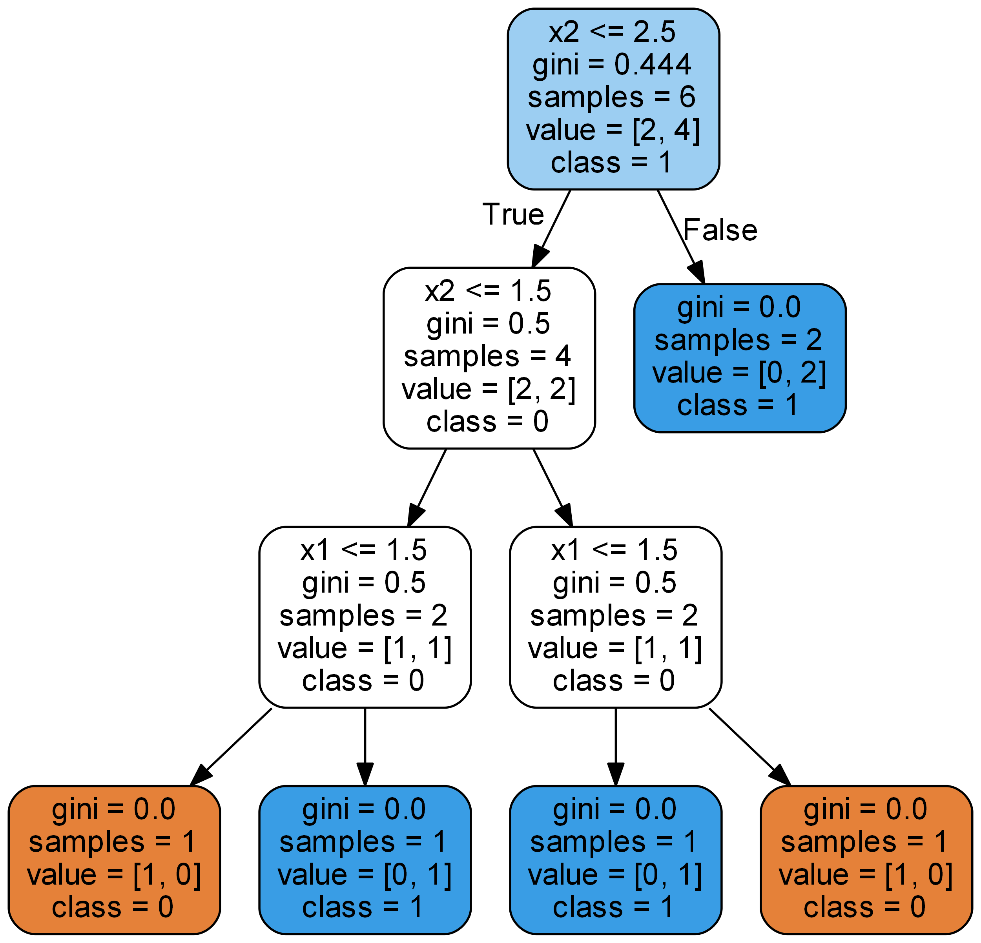
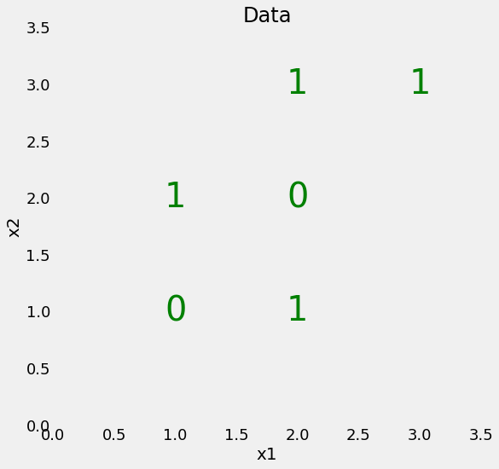
Decision tree
x
Will Koehresen
https://towardsdatascience.com/an-implementation-and-explanation-of-the-random-forest-in-python-77bf308a9b76

Slide 5
p₁
p₀
+
p₀
p₁
[1, 1, 1, 1, 0, 0]
[1, 1, 1, 1, 1, 1]
*
*
(1 - p₁)
(1 – p₀)
= 1 – (4/6)² – (2/6)²
[0, 0, 0, 1, 1, 1]
= (p₁ - p₁²)
(p₀ – p₀²)
= 0.44
+
[0, 0, 0, 0, 0, 0]
= p₁ + p₀ - p₁²- p₀²
= 1- p₁²- p₀²

Slide 6
Why Gini impurity?
x
Will Koehresen
https://towardsdatascience.com/an-implementation-and-explanation-of-the-random-forest-in-python-77bf308a9b76

Slide 7
Gini of a split = weighted average of splitted groups
=0.5 * (4/6) + 0 * (2/6)
=0.33
Will Koehresen
https://towardsdatascience.com/an-implementation-and-explanation-of-the-random-forest-in-python-77bf308a9b76

Slide 8
Find the best split
0.3333
0.4166
0.4166
0.4
Node
Find the best split
Return two groups
Find the best split
means
Find x2 <= 2.5

Slide 9
Implement the Tree (=Training)
X, y
Node
Find the best split
Return two groups
X1, y1
X2, y2
Node
Node
Find the best split
Return two groups
Find the best split
Return two groups
Return each split from each node
with classes
Implement Predict (=Testing)

Slide 10
When to stop?
When Gini = 0
When samples = 1
Will Koehresen
https://towardsdatascience.com/an-implementation-and-explanation-of-the-random-forest-in-python-77bf308a9b76

Slide 11


Calculate Gini
Calculate Gini of a split
Find the best split
Implement a node
Repeat nodes to build the tree
Random Forest
Randomly sample from data
Randomly sample from features

